Slide 1
Limestone College Concussion Policy

Slide 2
Objective
Understand concussion definition
Understand the signs and symptoms of concussion
Understand the basic structural and functional components of concussion
Understand what concussion looks like in the classroom
Knowledge of the Concussion Management Team (CMT)
Understand the return to learn policy following a concussion
Knowledge of the members of the CMT

Slide 3
The identification and management of sport-related concussion (SRC) has become one of the most hotly debated and intensely researched sports medicine topics of the 21st century. Perhaps no other sports medicine injury, in terms of its immediate and potentially long-term effects, has garnered the attention of the public, the media, sports participants and clinicians and researchers in the neurological sciences.

Slide 4
Common Concussion Myths

Slide 5
Common Concussion Myths

Slide 6
Common Concussion Myths

Slide 7
Common Concussion Myths

Slide 8
Limestone College SRC
2015-2016 14 reported SRC
2016-2017 12 reported SRC
2017-2018 36 reported SRC
2018-2019 58 reported SRC

Slide 9
Academic Difficulties
2017-2018 academic year: 36 SRC reported to the athletic training staff.
Thirty-three percent (n = 12/36) of student-athletes became ineligible for their sport during the recovery semester
72% (n = 26/36) had a decrease in grade-point-average from Fall 2017 to Spring 2018.
Sixteen percent (n = 6/36) of student-athletes were placed on academic suspension or withdrew from the institution.

Slide 10
What is a Concussion?
A change in brain function following a force to the head which may be accompanied by a temporary loss of consciousness but is identified in awake individuals with measures of neurologic and cognitive dysfunction.

Slide 11
Concussion is a traumatic brain injury induced by biomechanical forces.
Cause: direct blow to the head, face, neck or elsewhere on the body with an impulsive force transmitted to the head
Rapid onset of short-lived impairment of neurological function that resolves spontaneously. However, in some cases, signs and symptoms evolve over a number of minutes to hours.
Neuropathological changes, but the acute clinical signs and symptoms largely reflect a functional disturbance rather than a structural injury and, as such, no abnormality is seen on standard structural neuroimaging studies
Many clinical signs and symptoms that may or may not involve loss of consciousness. Resolution of the clinical and cognitive features typically follows a sequential course. However, in some cases symptoms may be prolonged

Slide 12
Symptoms of Concussions

Slide 13
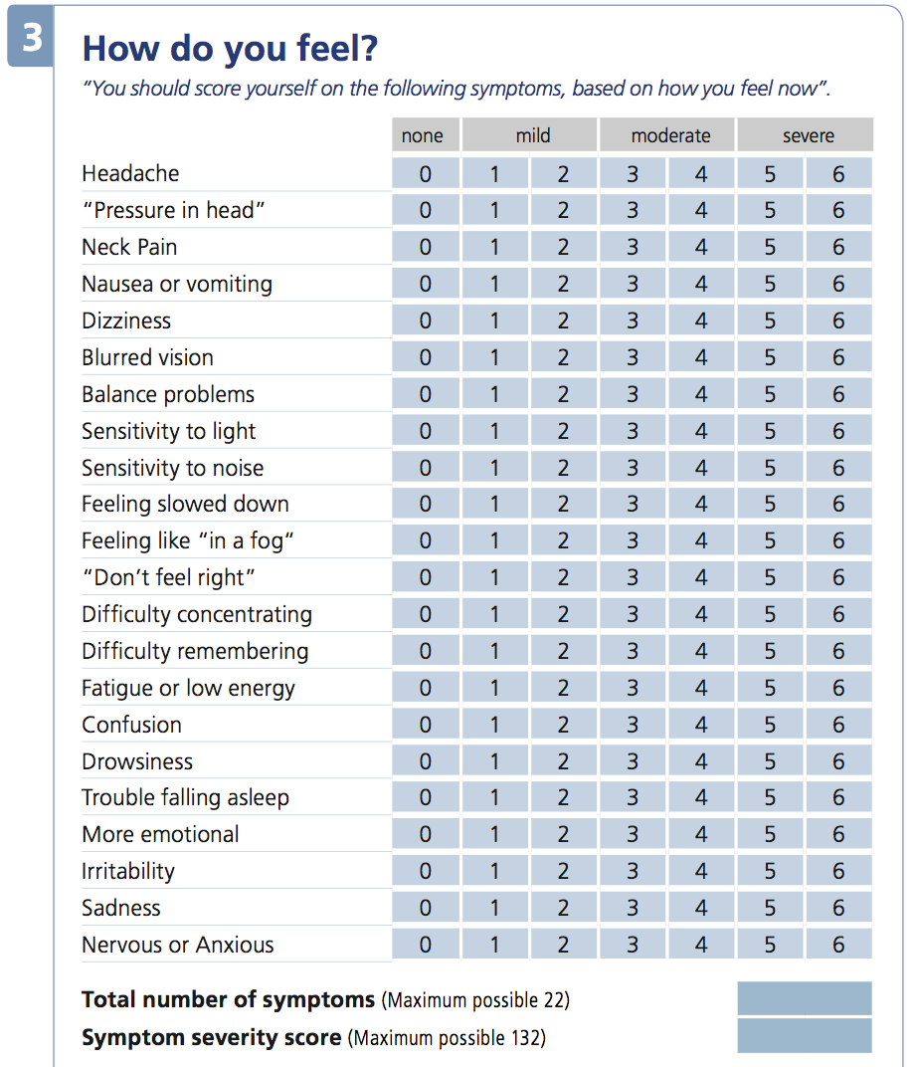
PCSS

Slide 14
NCAA Concussion Video

Slide 15
Mind, Body and Sport: Post-concussion syndrome
guide to understanding and supporting studentt-athlete mental wellness
What can coaches do?
Make sure student-athletes who sustain a concussion are immediately removed from play and that they do not feel pressure from the coaching staff to return to play before fully recovered. Communicating with team members before the season about concussion safety, and verbally reinforcing the importance of concussion safety throughout the season are important ways to encourage student-athletes to feel comfortable reporting concussion symptoms to medical personnel.
Student-athletes who are experiencing post-concussion syndrome may feel isolated from their team and from their normal social roles. These changes can manifest in mental health issues, such as depression, that are not a direct consequence of the initial injury. Be in touch with your student-athletes during their recovery period, communicate that they remain valued team members, and encourage help-seeking from relevant medical professionals, including mental health professionals as appropriate

Slide 16
How Concussions Can Affect Learning
Unique to each student
70-90% of all concussion resolve in 7-10 days
Post concussion symptoms can often interfere with a students ability to do academic work
Fatigue and sleep disruption may leave the student with out enough mental energy to participate in a full day of class work
Cognitive deficits which can exist even when a student is symptom free may make school participation difficult
The key issue is that the student, in general, will recover quicker with rest from physical activity as well as cognitive demands of academic work

Slide 17
Management of the student with a concussion
Academic Support during recovery
A careful balancing of rest with academic work and an individualized plan with evolving accommodations as symptoms change and the student recovers

Slide 18
What to look for after a concussion
When students return to school after a concussion, school professionals should watch for:
Difficulty paying attention and concentrating
Difficulty remembering or learning new material
Longer time needed to complete tasks or assignments
Difficulty organizing tasks or shifting between tasks
Inappropriate or impulsive behavior during class
Greater irritability
Less ability to cope with stress
More emotional than usual
Fatigue
Difficulty handling a stimulating school environment
Physical symptoms (headache, nausea, dizziness)

Slide 19
Additional Considerations
Students with a history of concussions may have prolonged symptoms with each subsequent injury
In more severe cases the student may have to drop classes if all attempts at accommodation fail and disabling symptoms continue with minimal academic effort
Injury from concussion falls under the American with Disabilities Act allowing students to progressively return to the classroom while allowing proper recovery time.

Slide 20
The Concussion Management Team CMT
Dawn Ranns FAR Point Person for CMT dranns@limestone.edu
Todd Morgan MD Team Physician
Adam Ranns ATC Assistant Director of Sports Health aranns@limestone.edu
Sandy Green RN School Nurse sgreen@limestone.edu
Mary Campbell School Councilor mcampbell@limestone.edu
Andrea Allision Representative for Disability Services aallision@limestone.edu
Faculty Members

Slide 21
1. Return to learn following a concussion 2. Accommodations for the Classroom Form
Faculty Forms

Slide 22
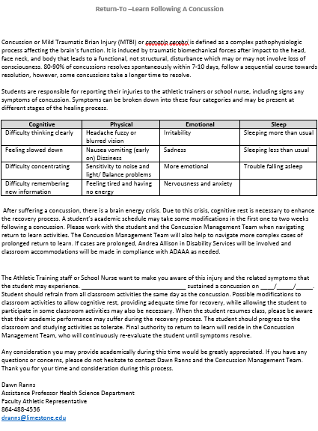

Slide 23
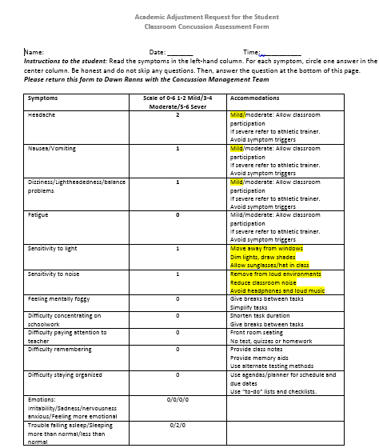

Slide 24
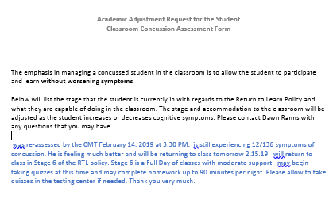

Slide 25
Return to Learn Policy at Limestone College
1. Excused from Classes
2. Immediate cognitive rest
3. Trial 10-30 minutes of light cognitive activity
4. Return to partial day of school
5. Full day with maximum support
6. Full day with moderate support
7. Full day with minimal support
8. Full day with no support needed

Slide 26
Step 1: Student Excused from Classes
The student will be excused from all classes at least the day of concussion.

Slide 27
Step 2: Immediate Cognitive Rest
The student will be instructed in cognitive rest in order to maximize healing conditions for concussion.
Limit reading, “screen-time” (texting, video game play, computer work) and any other cognitive activity that requires focus or concentration.
This phase could be limited to the same day as injury.

Slide 28
Step 3: Trial 10-30 Minutes of Light Cognitive Activity
A trial will be administered to the student by a member of the Concussion Management Team.
This may be reading or a math challenge.
If the student is unable to tolerate this activity they should stay home from school.
To move to the next stage the student needs to be able to sustain concentration for 30 minutes without symptoms increasing.

Slide 29
Step 4: Return to Partial Day of School
No more than 30-45 minutes of cognitive activity at one time, followed by 15 minutes of rest.
Student may attend 1-3 classes per day with interspersed rest breaks. There should be a minimal expectation for productivity with no tests or homework.
As students status continues to improve, being able to tolerate 4-5 hours of activity with breaks and no increase in symptoms, they may move to the next stage.

Slide 30
Step 5: Full Day with Maximum Support
Students attend most classes, with 2-3 rest breaks throughout the day of 20-30 minutes. No tests or quizzes.
Minimal homework of less than 60 minutes and minimal to moderate expectations for productivity.
To move to the next stage students should be able to tolerate increased demands with only 1-2 breaks needed.

Slide 31
Step 6: Full Day with Moderate Support
Attend all classes with 1-2 rest breaks throughout the day of 20-30 minutes.
May begin quizzes. Moderate homework up to 60-90 minutes and moderate expectations for productivity.
At this time a schedule can be established for make-up work.

Slide 32
Step 7: Full Day with Minimal Support
Attend all classes with 0-1 rest breaks throughout the day of 20-30minute.
May begin modified tests with breaks and extra time.
Homework of 90 minutes and maximum expectations for productivity.

Slide 33
Step 8: Full Day with no Support Needed
Attend all classes with no rest breaks.
There are maximum expectations for productivity and begin to added make-up work.

Slide 34
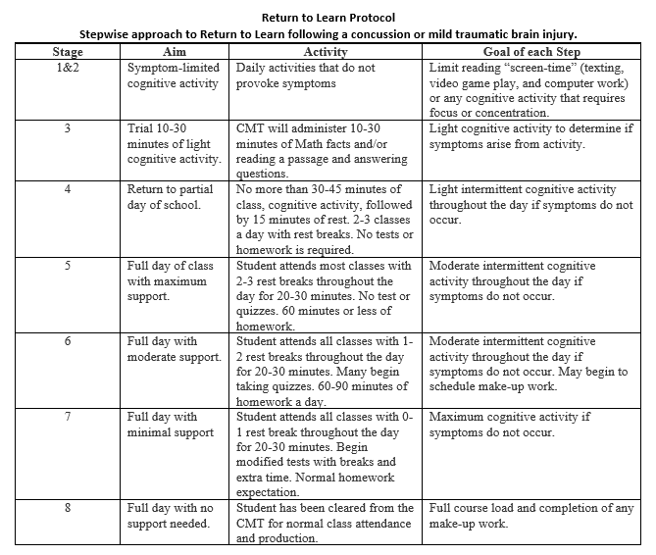
Return to Learn Policy

Slide 35
Return to Play Policy

Slide 36
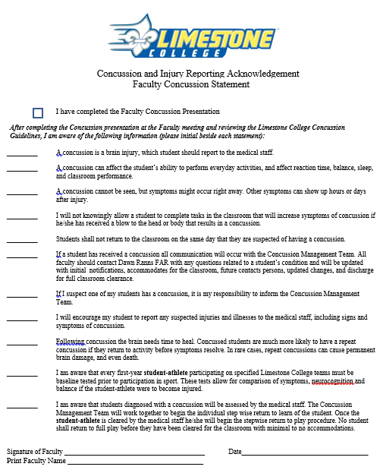

Slide 37
Questions?

