Slide 1
Return-to Learn Guidelines
LC RTL Policy
Concussion
The student will be excused from all classroom activities the same day as the initial concussion, and may remain at home/dorm if light cognitive activity cannot be tolerated.
Immediate cognitive rest: limit reading, “screen-time” (texting, video game play, computer work) and any other cognitive activity that requires focus or concentration.
Trial 10-30 minutes of light cognitive activity: (CMT) This may be reading or a math challenge.
Return to partial day of school: no more than 30-45 minutes of cognitive activity at one time, followed by 15 minutes of rest. 1-3 class a day with no homework or tests. When the student tolerates 4-5 hours of activity with breaks and no increase in symptoms move to step 5.
Full day with maximum support: attend most classes, with 2-3 rest breaks throughout the day of 20-30 minutes. No tests or quizzes. Minimal homework of less than 60 minutes and minimal to moderate expectations. To move to step 6 the student should be able to tolerate increased demands with only 1-2 breaks needed.
Full day with moderate support: attend all classes with 1-2 rest breaks. May begin quizzes. Moderate homework up to 60-90 minutes .
Full day with minimal support: attend all classes with 0-1 rest breaks. Begin modified tests with breaks.
Full day with no support needed.
Return to learn (RTL) is a parallel concept to return to play in that it is an individualized, stepwise program for successful reintegration into the classroom.
As concussion and mild traumatic brain injury are covered under the Americans with Disabilities Act Amendments Act (ADAAA), our program, in working with the campus disabilities office, is compliant with ADAAA law.
Signs Observed by Faculty | Symptoms reported by Student
Students appears dazed or stunned | Headache or pressure in head
Seems confused | Foggy or hazy feeling
Forgets class schedule or assignments | Nausea or vomiting
Moves clumsily | Double vision, blurry vision
Exhibits balance problems | Sensitivity to light or noise
Answers questions slowly | Feeling sluggish, fatigued or groggy
Repeats questions | Problems concentrating
Shows change in mood, behavior or personality (irritability, sadness, more emotionality, nervousness | Problems remembering
Forgets events prior to hit or fall | Just not feeling right or feeling down
Forgets events after hit or fall | Difficulty thinking clearly
Loses consciousness (even briefly) | Balance problems or dizziness
 | Numbness or tingling
 | Sleep problems
Notes:
To change this brochure, replace our sample content with your own. Or, if you'd rather start from a clean slate, press the New Slide button on the Home tab to insert a new page. Now enter your text and pictures in the empty placeholders. If you need more placeholders for titles, subtitles or body text, copy any of the existing placeholders, then drag the new one into place.
And did you notice we made fold marks for you? They are really light, but if you don’t like them showing on your brochure, select and delete them before you print.

Slide 2
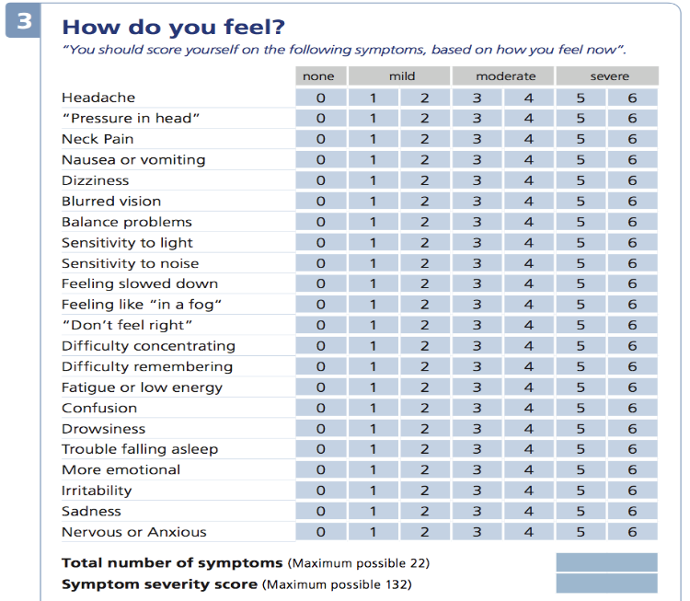
Mission of the CMT
Who can help when a student has a concussion?
The Concussion Management Team CMT
FAR: Chair: Dawn Ranns dranns@limestone.edu
HAT: Adam Ranns aranns@limestone.edu
Physician: Todd Morgan
Nurse: Sandy Green sgreen@limestone.edu
Disability Services: Andrea Allision aallision@limestone.edu
Counselor Mary Campbell mcampbell@limestone.edu
Three Faculty member representatives
All e-mail contact should start with Dawn Ranns FAR
Resources available for immediate assistance
1. Mary Campbell: 864-488-8280
The National Center for Performance Health:
1-866-684-2007
What is a Sport-Related Concussion (SRC)?
To assist the student to minimize cognitive stress while making an attempt to stay current academically.
The CMT shall make recommendations regarding the resumption of class work and class attendance in a gradual fashion for a period of up to two weeks.
In the ongoing monitoring of the concussed student the team physician, in conjunction with the CMT will make recommendations for continued or increased assistance for prolonged return to learn issues.
SRC is a traumatic brain injury induced by biomechanical forces.
Caused either by a direct blow to the head, face, neck or elsewhere on the body with an impulsive force transmitted to the head .
Results in the rapid onset of short-lived impairment of neurological function that resolves spontaneously. However, in some cases, signs and symptoms evolve over a number of minutes to hours.
Result in neuropathological changes, but the acute clinical signs and symptoms largely reflect a functional disturbance rather than a structural injury and, as such, no abnormality is seen on standard structural neuroimaging studies.
Results in a range of clinical signs and symptoms that may or may not involve loss of consciousness. Resolution of the clinical and cognitive features typically follows a sequential course.
What Happens When a Student has reported a Concussion?
Signs and Symptoms
Faculty and coaches will receive a return to learn letter and a Academic Adjustment Request via e-mail from a member of the concussion management team when a concussion has been reported to the athletic training staff or the school nurse.
Notes:
To change this brochure, replace our sample content with your own. Or, if you'd rather start from a clean slate, press the New Slide button on the Home tab to insert a new page. Now enter your text and pictures in the empty placeholders. If you need more placeholders for titles, subtitles or body text, copy any of the existing placeholders, then drag the new one into place.
And did you notice we made fold marks for you? They are really light, but if you don’t like them showing on your brochure, select and delete them before you print.

